Slide 1

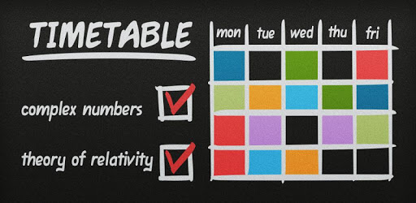

COURSE TIMETABLING
CS-254
Design & Analysis of Algorithm
Problem statement and
solution proposal
Neeraj Verma (170005020)
Dhruv Singhal (170001022)

Slide 2
Outline
The Problem
Solution Proposal
Algorithms
Analysis
Comparison

Slide 3
The Problem
To construct a timetable for University/School.
Realistic timetable construction problems are multidimensional because of large diversity in acceptance criteria.
Only heuristic solution approaches are practically possible.

Slide 4
Assumptions/Constraints
Design a course timetable with :
‘P’ periods in a day
‘D’ days in a week
‘N’ subjects
‘R’ professors
Maximum periods for S_{i} is X_{i}
Maximum periods for P_{i} is Y_{i}
Many to one mapping for S to P
No two subjects are placed together

Slide 5
Solution Proposal
Following approaches are used to solve the problem :-
GENETIC ALGORITHM
ANT COLONY OPTIMISATION

Slide 6
Solution description
GENETIC ALGORITHM
Based on the principles of Genetics and Natural Selection.
Survival of the fittest.
Start with a pool or a population of possible solutions.
These solutions undergo recombination and mutation.
Produce fitter next generation.
The fitter individuals are given higher chance to mate and yield “fitter” offspring.
Keep “evolving” better individuals or solutions over generations.
Repeat until target is reached.

Slide 7
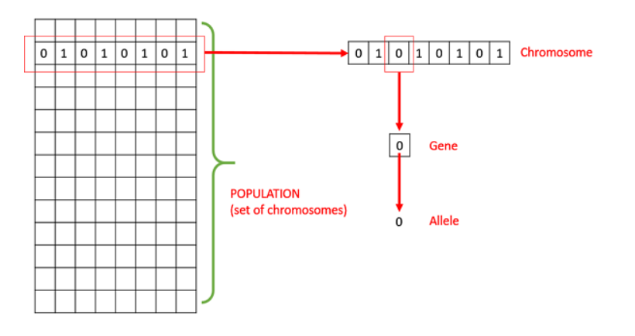
Basic Terminology
GENETIC ALGORITHM
Population : It is a subset of all the possible solutions to the given problem.
Chromosomes : One such solution to the given problem.
Gene : One element position of a chromosome.
Allele : It is the value a gene takes for a particular chromosome.

Slide 8
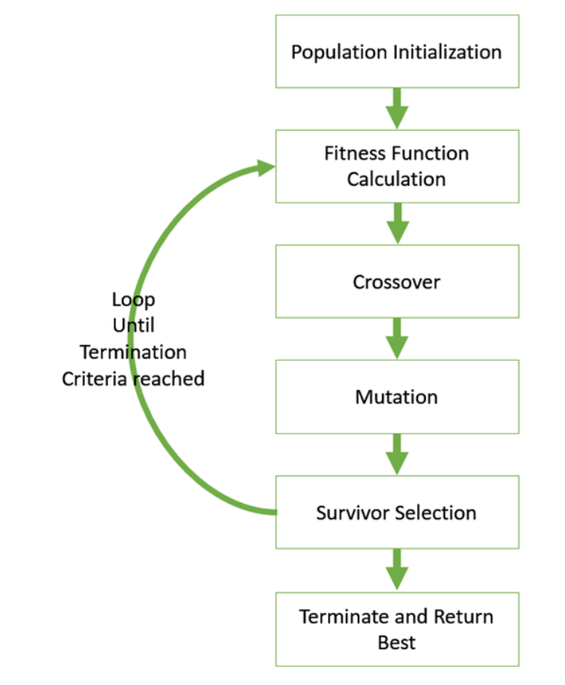
Basic Structure
GENETIC ALGORITHM
Start with an initial population (random/heuristic).
Select parents for mating.
Apply crossover and mutation on the parents to generate new off-springs.
These off-springs replace the existing individuals in the population.

Slide 9
Generalised Pseudo-code
GENETIC ALGORITHM
GA()
initialize population
find fitness of population
while (termination criteria is reached) do
parent selection
crossover with probability pc
mutation with probability pm
decode and fitness calculation
survivor selection
find best
return best

Slide 10
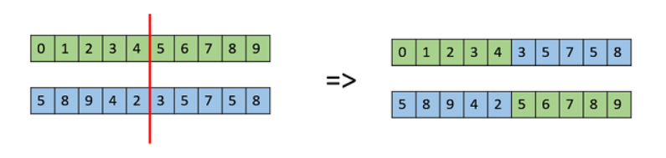
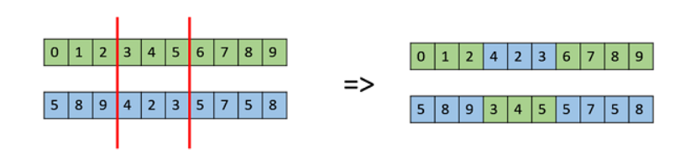
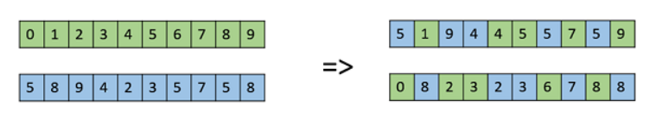
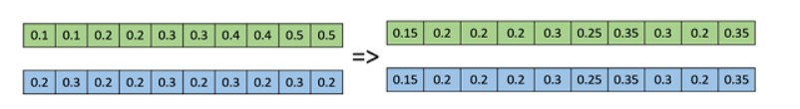
Crossover Operators
GENETIC ALGORITHM
One Point Crossover
Multi Point Crossover
Uniform Crossover
Whole Arithmetic Recombination

Slide 11




Mutation Operators
GENETIC ALGORITHM
Bit Flip Mutation
Swap Mutation
Scramble Mutation
Inverse Mutation

Slide 12
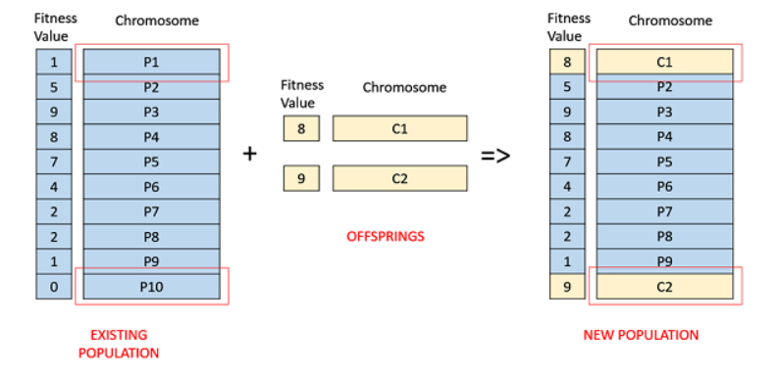
Fitness Based Selection
GENETIC ALGORITHM
Children tend to replace the least fit individuals in the population.

Slide 13
Terminating Condition
GENETIC ALGORITHM
When there has been no improvement in the population for X iterations.
When we reach an absolute number of generations.
When the objective function value has reached a certain pre-defined value.

Slide 14
Application in course timetabling
GENETIC ALGORITHM
Assuming total Subjects=6, Professors=3, Periods in a day=6, Days in a week=5
Denote Subjects with ‘A’,’B’,’C’,’D’,’E’ & ‘F’ respectively.
Target is to create a string of length 30, with the given constraints.
Begin with a pool of 100 strings of length 30 each.
Apply Genetic Algorithm on these to find fitter population.
The individual satisfying terminating condition is the final answer.

Slide 15
Solution description
Ant Colony Optimisation
Based on the principles of swarm movements.
Ants wander randomly.
Upon finding the food they return to their colony while secreting pheromone.
Another ant will tend to follow this path, then to wander randomly.
Pheromones have the tendency to evaporate, thus reducing its attractive strength.

Slide 16
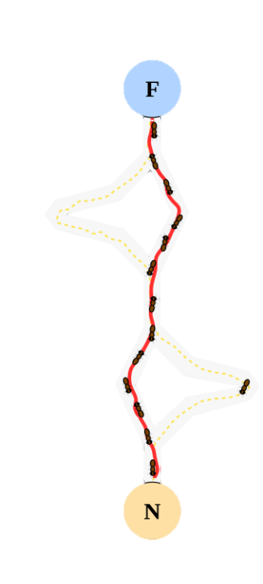
Basic Terminology
Ant Colony Optimisation
Nest : Source of the ants..
Food : Target.
Pheromone : A chemical substance used to propagate some information through its fragrance.

Slide 17
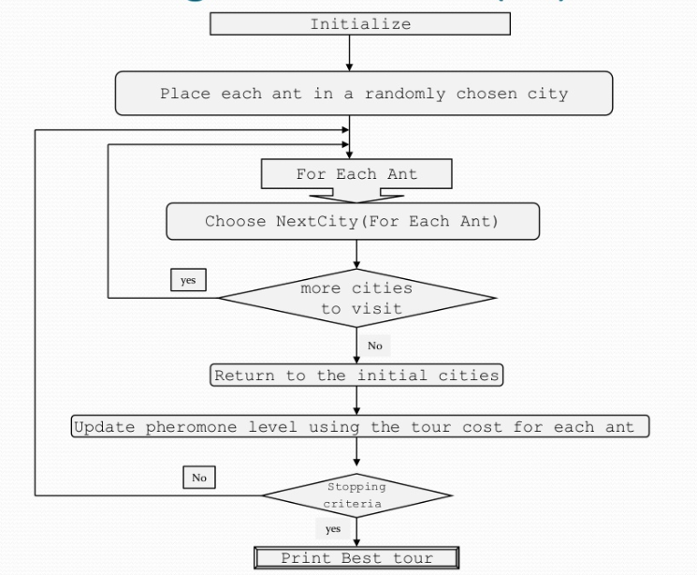
Basic Structure
Ant Colony Optimisation
Initialize the ants.
Allow them to move randomly from a source while leaving pheromones.
Virtual trail accumulated on the path segments.
Path selected at random based on the amount of “trail” present.
Ant reaches next node.
Continues until reaches starting node.
Finished tour is a solution.

Slide 18
Generalised Pseudo-code
Ant Colony Optimisation
Begin
Initialize
while stopping criterion not satisfied do
position each ant at a node
repeat
for each ant do
choose next node by applying the transition rules
apply step by step pheromone update
end for
until every ant has built a solution
update best solution
end while
End

Slide 19

Transition rules
Ant Colony Optimisation
An ant will move from node i to node j with probability
$$p_{ij}=\frac{({T^{a}}_{ij})({n^{b}}_{ij})}{\sum{({T^{a}}_{ij})({n^{b}}_{ij})}}$$
Where,
T_{ij} is the amount of pheromone on edge i,j
a is a parameter to control the influence of T_{ij.}
n_{ij} is the desirability of edge I,j (typically 1/d_{ij}).
b is a parameter to control the influence of n_{ij.}

Slide 20
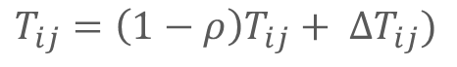
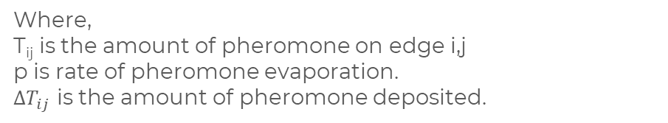
Pheromone Update
Ant Colony Optimisation
Amount of pheromone is updated according to the equation
$$T_{ij}={\left(1−ρ\right)T}_{ij}+ {∆T}_{ij})$$
Where,
T_{ij} is the amount of pheromone on edge i,j
p is rate of pheromone evaporation.
${∆T}_{ij}$ is the amount of pheromone deposited.

Slide 21
Application in course timetabling
Ant Colony Optimisation
Assuming total Subjects=6, Professors=3, Periods in a day=6, Days in a week=5
Denote Subjects with ‘A’,’B’,’C’,’D’,’E’ & ‘F’ respectively.
Design 30 cities such that they denote 30 periods.
Two cities can be of same subject.
Distance between the cities denote conflicts between them.
Apply Ant colony optimisation to this structure.
The best route will be the best possible solution.

Slide 22
Algorithms
GENETIC ALGORITHM
ANT COLONY OPTIMISATION

Slide 23
Analysis
Genetic algorithm
Following methods are used in the implementation :
mutatedGene()
createGnome()
mate()
conflictSubHours()
conflictProfHours()
conflictSubCount()
calcFitness()
main()

Slide 24
Variables
Complexity
main()
initialization -> N*p*d*(S+P)
while -> runs at most FX times
sort() -> Z.log(Z)
for each Individual -> Z
mate() -> p*d
end for
offspring ->p*d*(S+P)
end while
end main
O(N*p*d*(S+P)+FX(Z.log(Z) +Z*p*d+p*d*(S+P)))
Z is mostly constant, hence, complexity depends upon fitness function.
Complexity of fitness function -> O(p*d*(S+P))
N : Subject size
P : Professor size
p : Period size
d : Day size
X : Stopping criteria (if unchanged after X iterations)
F: Maximum fitness value
Z : Population size

Slide 25
Analysis
Ant Colony Optimisation
Following methods are used in the implementation :
graph()
initPheromones()
indexofTarget()
initAnts()
length()
bestTrail()
probability()
buildTrail()
updatePheromones()

Slide 26
Variables
Complexity
main()
graph() -> N²
while -> at most T
updateAnts() -> M*N
updatePheromones() -> M*N²
bestTrail() -> M+N
end main
O(N² + T(M*N+M* N² + (M+N))
Therefore, overall complexity is O(T*M* N²).
N : Number of cities
M : number of ants
T : maxtime

Slide 27
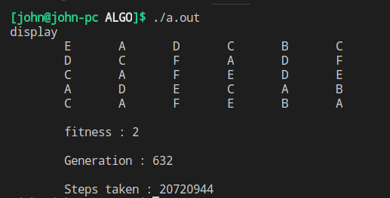
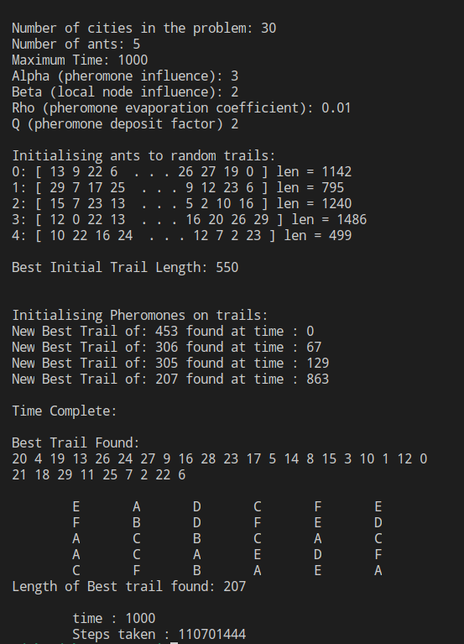
Comparison
Genetic Algorithm : 2,07,20,944 steps
For same set of input in Genetic Algorithm & Ant Colony Optimisation
Ant Colony Optimisation :
11,07,01,444 steps

Slide 28
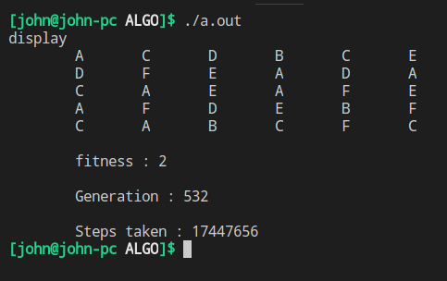
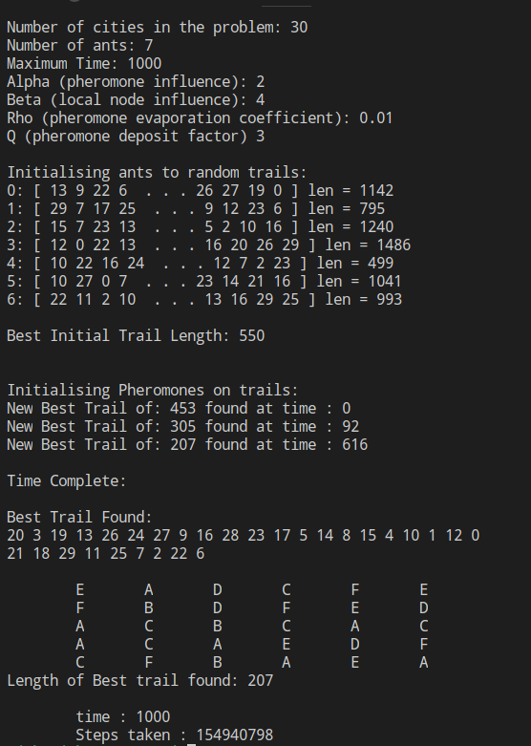
Comparison
Genetic Algorithm : 1,74,47,656 steps
For same set of input in Genetic Algorithm & Ant Colony Optimisation
Ant Colony Optimisation :
15,49,40,798 steps

Slide 29
Thank You

